Slide 1
Global Warming temperature forecasting
A look into the future

Slide 2
Phases of the project
Problem Identification
Context
Criteria for success
Scope of solution space
Constraints
Data sources
Model Construction
Data Wrangling
Exploratory Data Analysis (EDA)
Pre-processing and training data
Modeling

Slide 3
Problem Identification
Goal: Estimate the temperature by country on the next 3 years
Context : Global warming is affecting the temperature of our world. Affecting the summers to be hotter and the winters to be colder every year, or at least, that is the perception. The data here contains a recompilation of min and max temperatures from 1850 onwards that will show us is this feeling is true or that is a mare perception?
Criteria for success: A prediction of the future temperatures with a reliable cross time series validation.

Slide 4
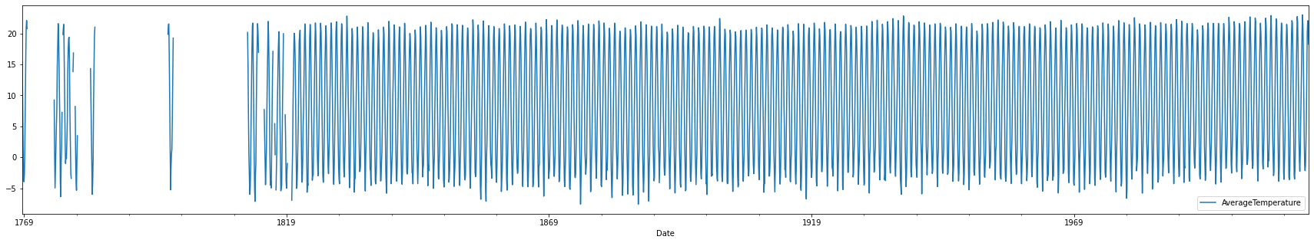
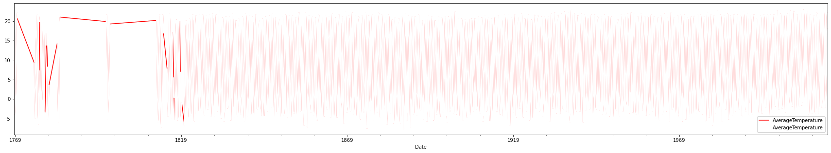
Data WRANGLING– source data – 577,462 entries, 2,325 for US
Since there are missing values before 1830, I truncated the entries to not affect the seasonality (if any)

Slide 5
Pre-processing and Training Data, and Modeling
For training the data, I separated the last 3 years of data for testing and used the rest for training.
Multiple ARIMA models were evaluated, and the model selected had an AIC of 6313.599 and configuration of ARIMA(1, 0, 4)(1, 0, 3, 12) and a MSE of 0.74°C
Also, a Prophet model was executed giving a 0.75 of MSE.

Slide 6
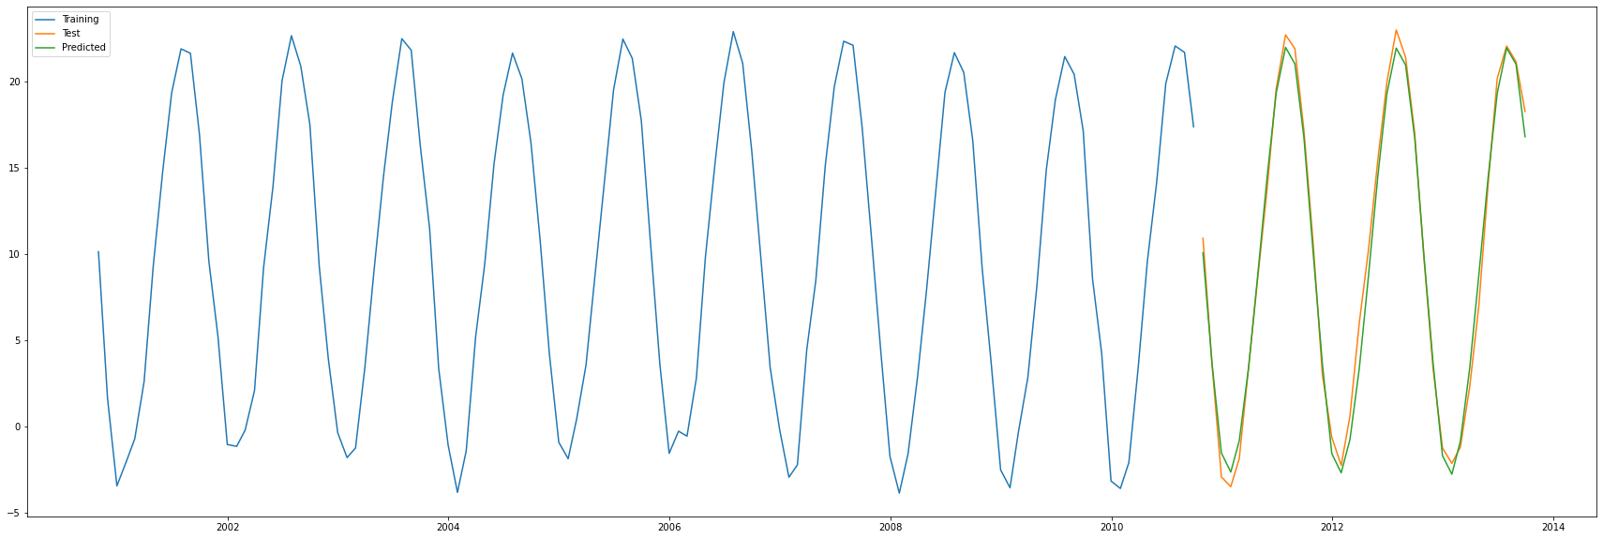
Results of ARIMA prediction (2011-2013)

Slide 7
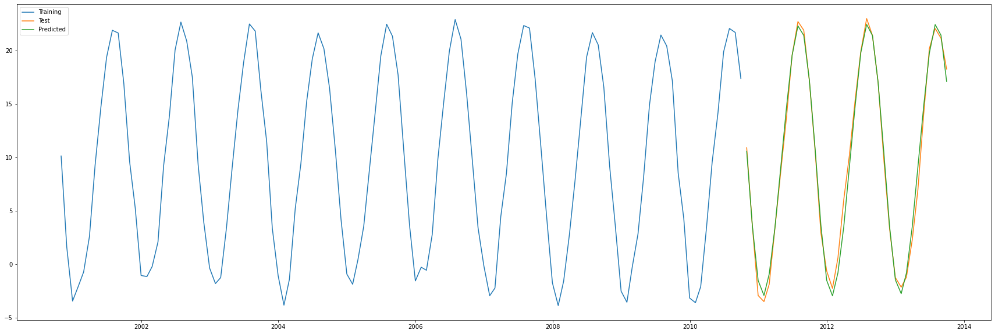
Results of PROPHET prediction (2011-2013)

Slide 8
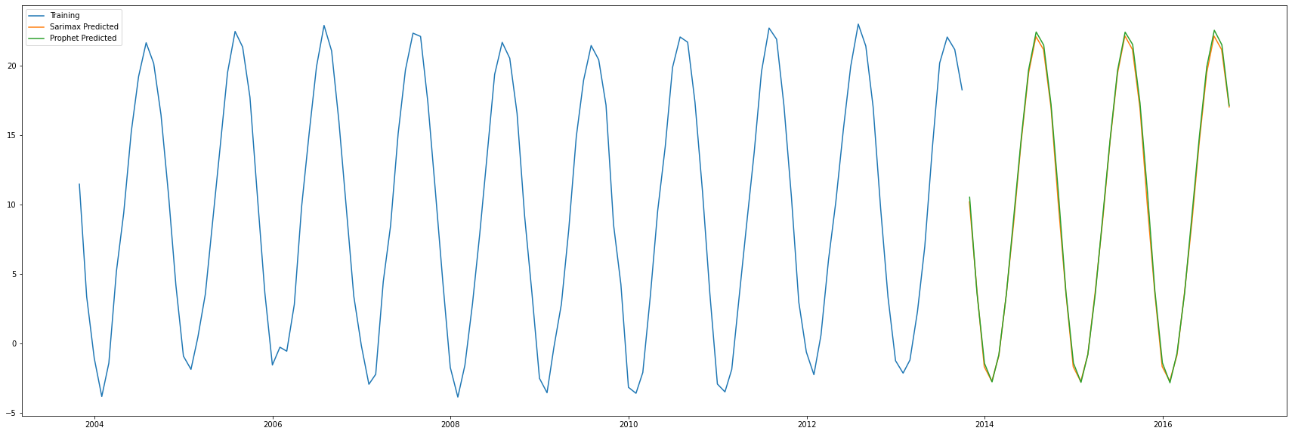
PREDICTING the future (2014-2016)

Slide 9
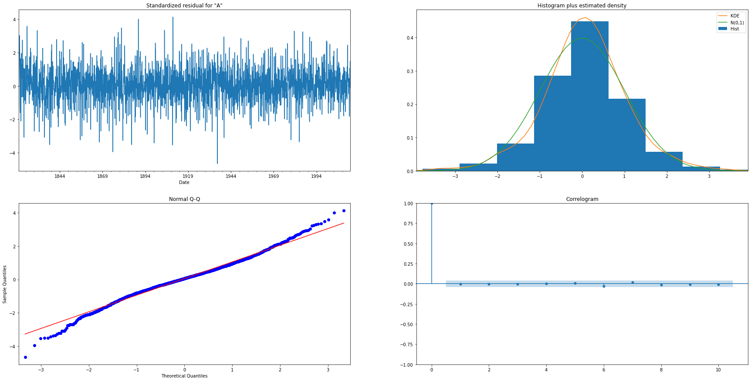
ARIMA performance

Slide 10
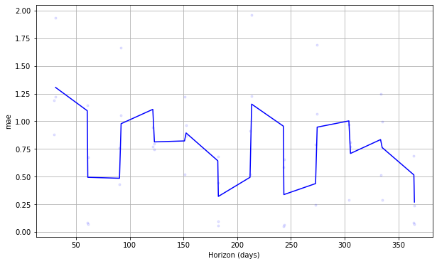
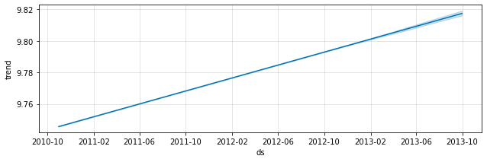
PROPHET PERFORMANCE

